Slide 1
Integrating SAP S/4HANA Cloud with SAP IBP using SAP Integration Suite
Digital Transformation with Cloud ERP
Reinhard Sudmeier
Add parner logo and alt text

Slide 2


Slide 3

Divider Page

Slide 4



Slide 5

Agenda
Agenda item/divider headline
Details
Agenda item/divider headline
Details
Agenda item/divider headline
Details
Agenda item/divider headline
Details

Slide 6
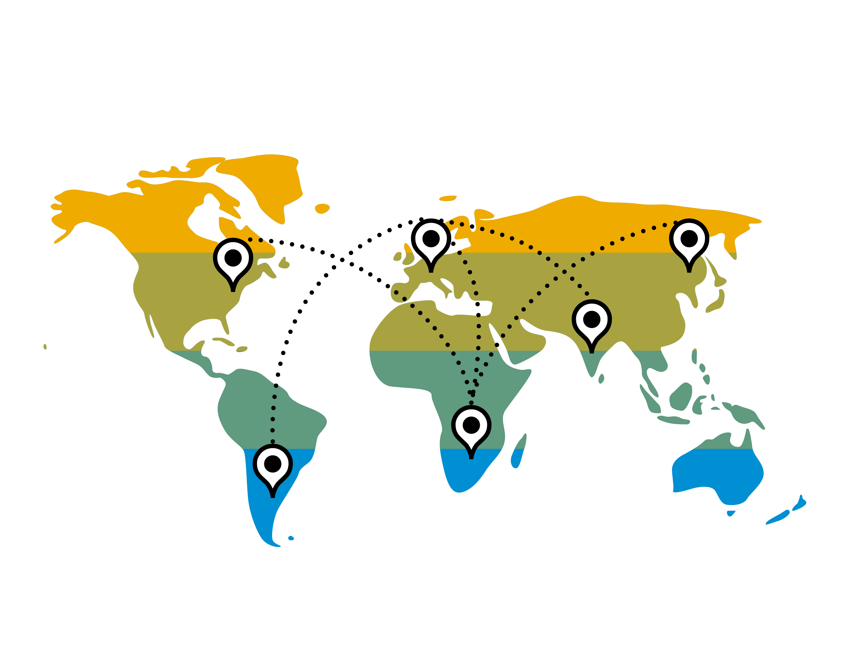

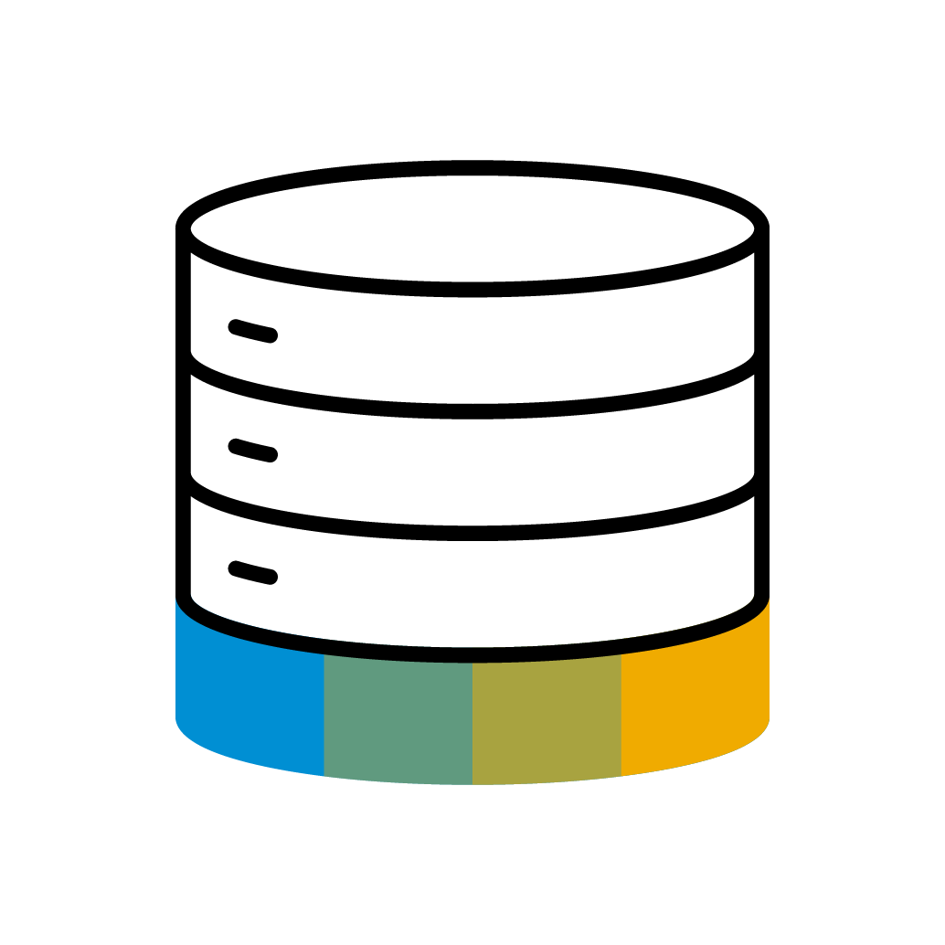

SAP Supply Chain Planning Platform
Connect strategic and operational planning with real-time visibility and execution
Digital Business Planning
PLAN
SAP Integrated Business Planning (IBP) for Supply Chain
Digital Twin of the entire supply chain
Predictive and Prescriptive Decision Support
Real-time scenarios and Intelligent Visibility
Impact Analysis & Optimization
EXECUTE
COLLABORATE
SAP S/4HANA
SAP Business Network
Leverage proximity to core for transactional planning and scheduling, order promising and service parts planning.
High scalability with access to trading partners (including suppliers, logistics providers, and customers) for collaborative planning and execution
INNOVATE
SAP Analytics Cloud (SAC)
Financial planning, steering and financial impact analysis on enterprise level
SAP Artificial Intelligence
Leverage AI technology to improve master data quality, manage supply chain risk and improve sustainability
This is the current state of planning and may be changed by SAP at any time.
Notes:
Highlighting main elements that are key to SCP strategy
SAP IBP addresses the network planning, for understanding and executing decisions that may go well beyond the enterprise core.
SAP IBP therefore needs to be flexible relative to the modeling and provide for scenario and simulation capabilities
SAP IBP: S&OP, Demand, Supply, Inventory, Control Tower, DDMRP
SAP S/4HANA houses functionality that are transactional in nature and we leverage proximity to the enterprise core: Production Planning, Available to Promise, embedded DDMRP, eSPP
SAP Analytics Cloud - Strategic and Financial Planning and Steering of an Enterprise
SAP Business Network is a large business network, so we are leveraging that scalable model to bring our business partners to the table for our supply chain planning and execution
SAP Business Network: Collaborative Planning, Multi-Tier Order Orchestration, Quality Inspections, Notifications, Review

Slide 7



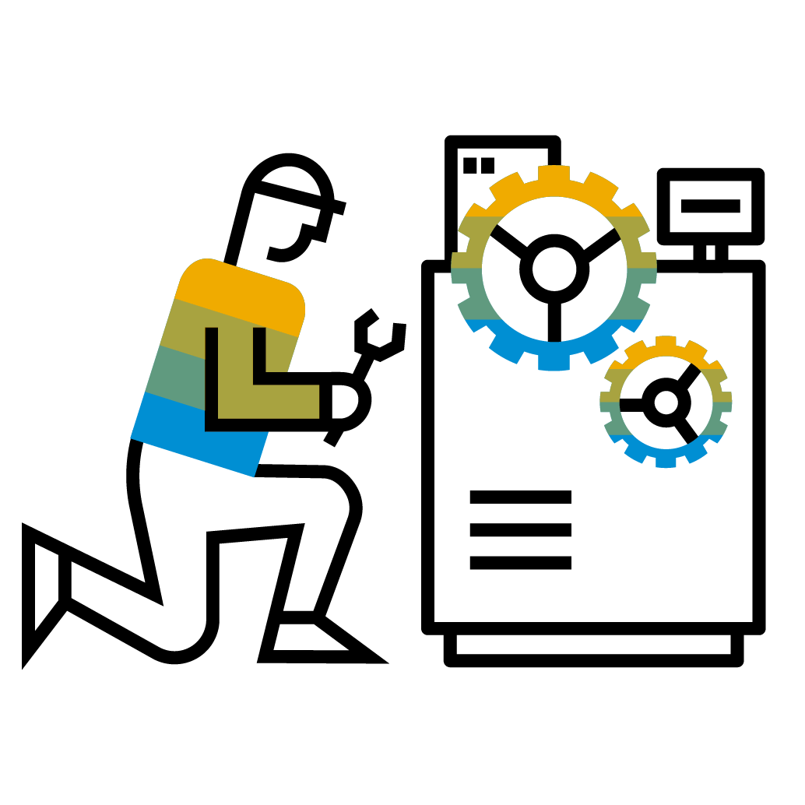




S/4HANA Cloud, public edition
Complete coverage for business activities
Finance
Accounting and financial close
Receivables and Payables mgmt.
Cost mgmt. & profitability analysis
Treasury & working capital mgmt.
Governance Risk and Compliance
Procurement
Direct material procurement
Service procurement
Supplier management
Central procurement
Sales
Sell Products, Projects and Contract-based Services separately or as a full solution
Convergent & External Billing
Service
After-sales service and support with contracts, service deliveries, and billing
Combine sales & services as packaged solution offerings
Service-Centric Industries
Professional services
Public sector
Higher education
Media
Financial services
Predictive Contracts
SAP S/4HANA Cloud, public edition
Manufacturing
Material requirements planning with demand driven and/or predictive MRP
Make to stock and make to order
Quality management
Environment, Health and Safety
R&D
Product compliance
Enterprise portfolio and project management
Advanced Variant configuration
Asset management
Reactive and proactive maintenance
Resource scheduling for maintenance planner
Enhanced collaboration + review
Supply chain
Warehouse Outbound & Inbound Processing
Core Inventory Management
(Advanced) ATP Processing
Basic Transportation Mgmt.
Product-Centric Industries
Component manufacturing
Hi-tech
Automotive
Mining services

Slide 8
What is the best way to integrate data with IBP? Overview of Main Integration Scenarios for SAP IBP
Demand, Inventory, Sales & Operations and Tactical Supply Planning
Operational Supply Planning, Synchronized Planning, Deployment and Response Management
Other Integration Scenarios
Collaboration
Integrated Financial and Supply Chain Planning, Analytics, new Product Introductions, etc.
IBP Data Model
Master Data and Transactional Data (Time-Series and Order-Based Data)
SAP Cloud Integration for data services (CI-DS)
SAP Smart Data Integration (SDI)
SAP Real-Time Integration (RTI)
Direct Connection
OData Services
sunset
Data Model by configuration
Master & Time-Series data
Periodic loads
Data Model by API
Master & Order Data
Periodic loads
Built-in Integration
Automatic sync of Master & Order Data
Supplier Commit /
Social Collab.
Master Data, Time-Series, Keyfigures
Periodic loads
S/4HANA On-Premise, SAP ERP, SAP APO, SAP BW, any source
SAP ERP S/4HANA On-Premise S/4HANA Cloud, private edition
SAP Ariba, SAP Workzone (JAM)
SAP Analytics Cloud, 3rd party tools
For more information on the integration scenarios in SAP IBP, please read the SAP Help Documentation
Notes:
We talked earlier briefly about integration and now we go into more details about the different data integration scenarios.
We start at the top of the diagram on this slide and work our way down
At the top we have the processes.
On the top left side we have the time series based and more tactical, meaning mid- and long-term planning, oriented processes: Sales and Operations, Demand and Inventory planning, plus Demand Driven Replenishment, short DDR, also called Demand Driven MRP). They integrate via Cloud Integration Data Services, short CI-DS. The data model is defined by master data and transactional time series data. This typically integrates to ERP systems, APO, and many other sources
In the top middle box we have the Operational planning, also called Order based planning, which uses SAP HANA Smart Data Integration, short SDI and since release 2111, November 202, also Real-Time integration, short RTI. We will talk more about RTI in the next slides and have a slide at the end of the integration section with a decision tree when customers should use SDI and when RTI.
We also have other integration scenarios for collaboration with Ariba and Work Zone (until 2021 this was JAM) via direct connection
And integration via OData services for master data, transactional data, visibility filters and IBP logging data. You can also use OData services to extract data from IBP to BI systems, e.g. SAP Analytics Cloud or non-SAP systems
The link to the SAP Help documentation for Integration Scenarios will also help you to understand the different integration options better

Slide 9
What is the best way to integrate data with IBP? Overview of Main Integration Scenarios for SAP IBP
Demand, Inventory, Sales & Operations and Tactical Supply Planning
Operational Supply Planning, Synchronized Planning, Deployment and Response Management
Other Integration Scenarios
Collaboration
Integrated Financial and Supply Chain Planning, Analytics, new Product Introductions, etc.
IBP Data Model
Master Data and Transactional Data (Time-Series and Order-Based Data)
SAP Cloud Integration for data services (CI-DS)
SAP Cloud Integration (CI)
SAP Smart Data Integration (SDI)
SAP Real-Time Integration (RTI)
Direct Connection
OData Services
sunset
Data Model by configuration
Master & Time-Series data
Periodic loads
Data Model by configuration
Master & Time-Series data
Periodic loads
Data Model by API
Master & Order Data
Periodic loads
Built-in Integration
Automatic sync of Master & Order Data
Supplier Commit /
Social Collab.
Master Data, Time-Series, Keyfigures
Periodic loads
S/4HANA On-Premise, SAP ERP, SAP APO, SAP BW, any source
S/4HANA Cloud, public edition
SAP ERP S/4HANA On-Premise S/4HANA Cloud, private edition
SAP Ariba, SAP Workzone (JAM)
SAP Analytics Cloud, 3rd party tools
For more information on the integration scenarios in SAP IBP, please read the SAP Help Documentation
Notes:
We talked earlier briefly about integration and now we go into more details about the different data integration scenarios.
We start at the top of the diagram on this slide and work our way down
At the top we have the processes.
On the top left side we have the time series based and more tactical, meaning mid- and long-term planning, oriented processes: Sales and Operations, Demand and Inventory planning, plus Demand Driven Replenishment, short DDR, also called Demand Driven MRP). They integrate via Cloud Integration Data Services, short CI-DS. The data model is defined by master data and transactional time series data. This typically integrates to ERP systems, APO, and many other sources
In the top middle box we have the Operational planning, also called Order based planning, which uses SAP HANA Smart Data Integration, short SDI and since release 2111, November 202, also Real-Time integration, short RTI. We will talk more about RTI in the next slides and have a slide at the end of the integration section with a decision tree when customers should use SDI and when RTI.
We also have other integration scenarios for collaboration with Ariba and Work Zone (until 2021 this was JAM) via direct connection
And integration via OData services for master data, transactional data, visibility filters and IBP logging data. You can also use OData services to extract data from IBP to BI systems, e.g. SAP Analytics Cloud or non-SAP systems
The link to the SAP Help documentation for Integration Scenarios will also help you to understand the different integration options better

Slide 10






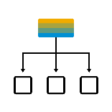

Connect and automate your business Integration capabilities of SAP BTP
Cloud Integration
API Management
Business Accelerator Hub
Integration Assessment
Integrate applications and data across diverse landscapes everywhere.
Expose your data and processes as APIs. Provide abstracted access to enterprise data via Graph. Manage E2E life cycle.
Jump-start integration projects with APIs, packaged integration content and adapters.
Shaping and execution of your integration technology strategy.
Integration Advisor | TPM
Open Connectors
Event Mesh*
Migration Assessment
Accelerate implementation and maintenance of B2B scenarios using machine learning.
Accelerate connectivity to third-party applications.
Enabling applications, integrations and extensions to communicate asynchronously through events.
Modernize your integration platform by smoothly transition to the cloud from SAP Process Orchestration.
SAP Integration Suite, advanced event mesh
*An event broker capability within SAP Integration Suite planned for Q4 2023, subject to change

Slide 11
Connect and automate your business Integration capabilities of SAP BTP
Cloud Integration
API Management
Business Accelerator Hub
Integration Assessment
Integrate applications and data across diverse landscapes everywhere.
Expose your data and processes as APIs. Provide abstracted access to enterprise data via Graph. Manage E2E life cycle.
Jump-start integration projects with APIs, packaged integration content and adapters.
Shaping and execution of your integration technology strategy.
Integration Advisor | TPM
Open Connectors
Event Mesh*
Migration Assessment
Accelerate implementation and maintenance of B2B scenarios using machine learning.
Accelerate connectivity to third-party applications.
Enabling applications, integrations and extensions to communicate asynchronously through events.
Modernize your integration platform by smoothly transition to the cloud from SAP Process Orchestration.
SAP Integration Suite, advanced event mesh
*An event broker capability within SAP Integration Suite planned for Q4 2023, subject to change

Slide 12
Why use SAP Cloud Integration Key advantages of this particular architecture
This is an innovative cloud to cloud integration
Configuration based easy to setup during implementation project
Ensures Master Data consistency throughout both systems
Bi-directional transfer of transactional data
It supports initial load and delta integration of both master and transactional data
Built-in within SAP Integration Suite, supports all current and future software releases
Built-in extensibility with the possibility to add custom-configured iFlows
Built-in extensibility with the creation of reusable iFlows for other business processes
The go-to for all new S/4HANA Cloud public edition implementations (With the covered business scope)

Slide 13


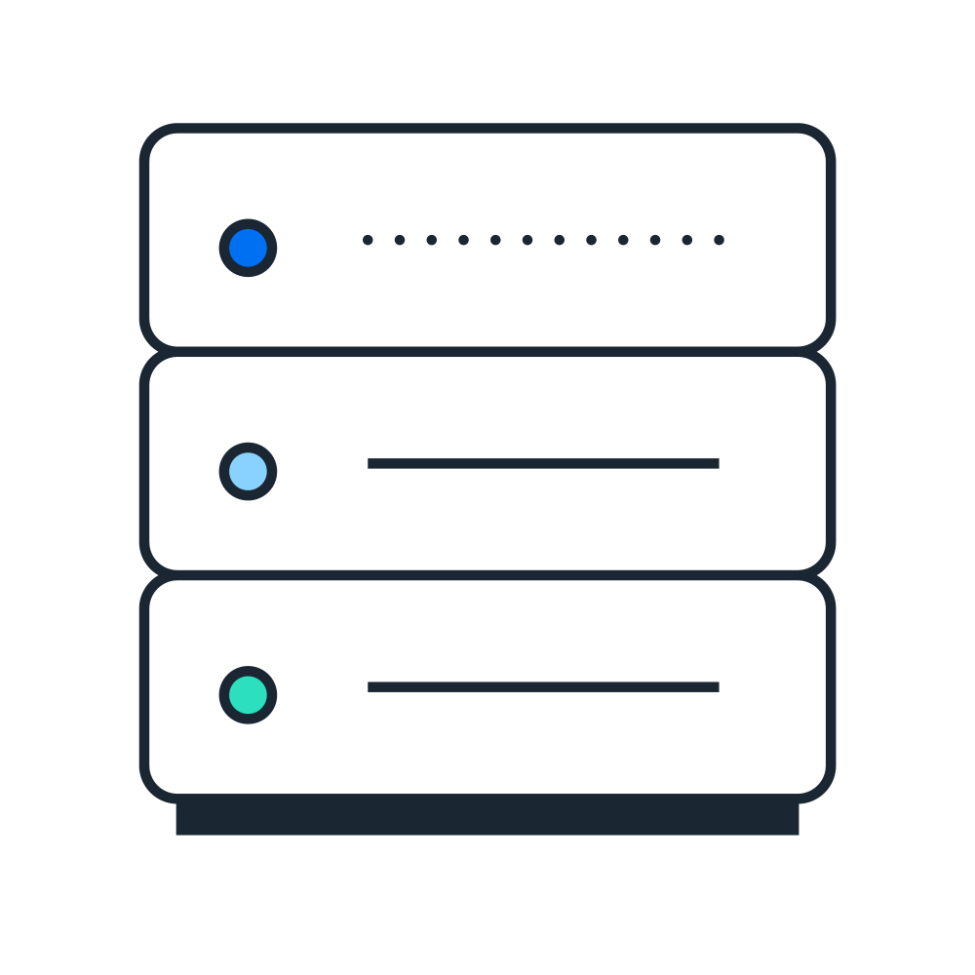





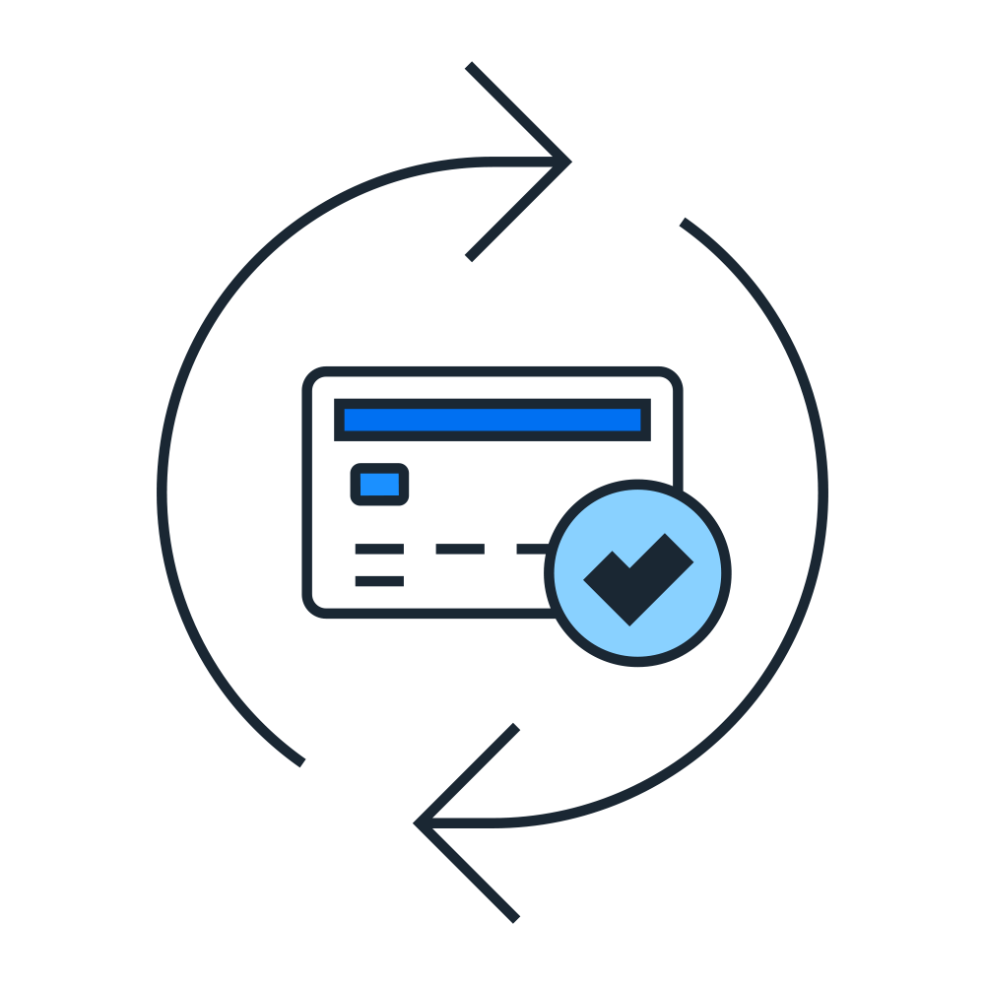




Demand Forecasting Scenario
Master Data
Products
Plants
Business Partners
Sales Order History
Sales History
Demand Planning
Planned Independent Requirements
Demand Plan
SAP S/4HANA Cloud, public edition
SAP Integrated Business Planning

Slide 14


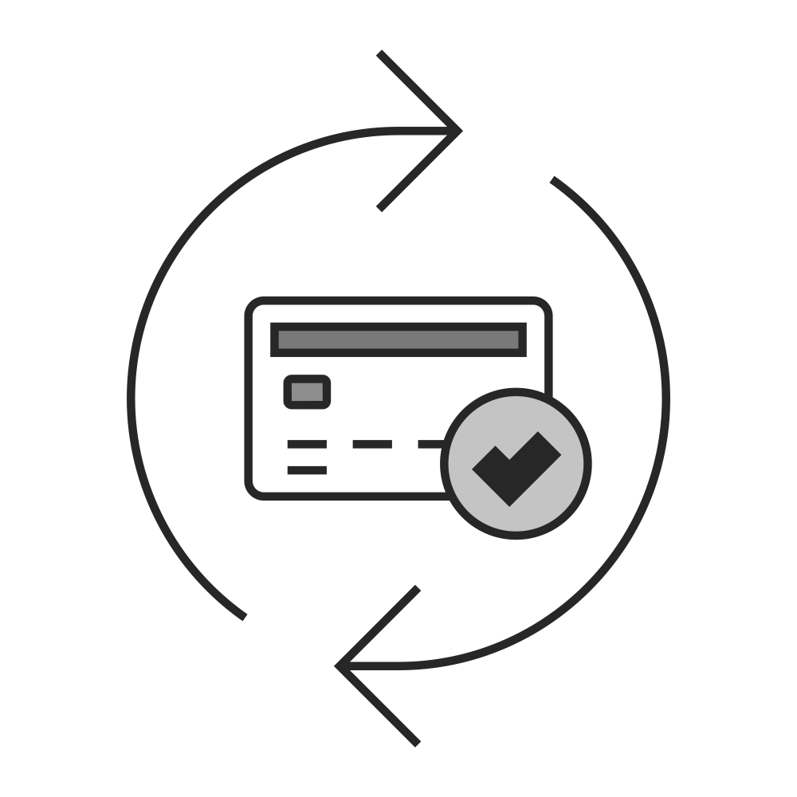




Demand Forecasting Scenario
Master Data
Products
Plants
Business Partners
Sales Order History
Sales History
Demand Planning
Planned Independent Requirements
Demand Plan
SAP S/4HANA Cloud, public edition
SAP Integrated Business Planning

Slide 15



Demand Forecasting Scenario
Master Data
Products
Plants
Business Partners
Sales Order History
Sales History
Demand Planning
Planned Independent Requirements
Demand Plan
SAP S/4HANA Cloud, public edition
SAP Integrated Business Planning

Slide 16



Demand Forecasting Scenario
Master Data
Products
Plants
Business Partners
Sales Order History
Sales History
Demand Planning
Planned Independent Requirements
Demand Plan
SAP S/4HANA Cloud, public edition
SAP Integrated Business Planning

Slide 17

Possible Integrations of ERP Systems to SAP IBP Can SAP IBP handle integrations to multiple ERP Systems
ERP SYSTEMS INTEGRATION POSSIBILITIES
SAP Integrated Business Planning can be integrated to multiple ERP Systems at the same time
These systems can be legacy or current ERP systems.
Public cloud, private cloud and on premise systems.
The integration allows for transfer of both transactional and master data
Different types of integrations (CI-DS, RTI, CI, oData,…) can coexist within the same SAP IBP System
SAP Integrated Business Planning
SAP ECC
Non SAP ERP System
SAP S/4HANA Cloud, public edition
SAP S/4HANA Cloud, private edition
SAP S/4HANA On Premise
This is the current state of planning and may be changed by SAP at any time.
Notes:
SAP S/4HANA Manufacturing for Planning and Scheduling (MP&S) is also referred to as PP/DS

Slide 18
Best Practice Your guide into accelerating the implementation of this integration
A new SAP Best Practice has been introduced specifically for this integration
Named: IBP for demand – demand forecast for SAP S/4HANA Cloud – ID 78P
The best practice covers both the integration and the business process in 6 steps
Data replication from S/4HANA Cloud to SAP IBP
Cleanse Historical Data
Run Statistical Forecasting
Analyze Forecast Quality
Analyze and Adjust Forecasting Results
Data replication from SAP IBP to S/4HANA Cloud
This best practice is part of a chain of integrated processes with preceding and succeeding practices to cover an end to end supply chain plan

Slide 19
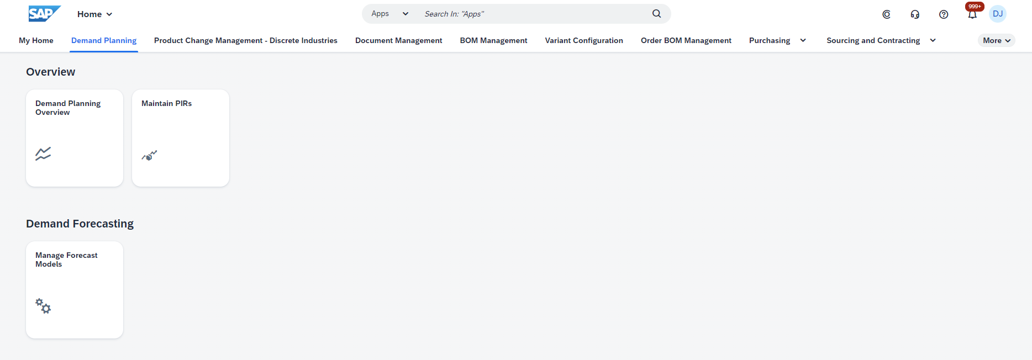
User Interface Integration Simplify your business process with a combined user interface
One unique access point with Fiori Launchpad.
An IBP Fiori Tile is added to S/4HANA Fiori Launchpad
Full description within the best practice

Slide 20



Slide 21


Slide 22

PUBLIC

Slide 23



PUBLIC
23

Slide 24
Insert page title (sentence case)
Start typing to add text without a bullet point. To add a bullet point, place the cursor at the start of this line and press tab.
Second level
Third level

Slide 26



Slide 27
PUBLIC
27

Slide 28
PUBLIC

Slide 29

Upskill for the future with SAP TechEd Virtual – Learning zone
Insert this mandatory slide into your presentation as it promotes the Learning Zone for SAP TechEd virtual
Talk track is available in the Notes
Visit the new Learning zone! Dive deeper into this year’s hottest topics with tailored learning to optimize your skills. Access free self-paced learning journeys, demos, and trials, and get hands-on learning with use cases to upskill in the latest innovation areas.
Explore learning offerings for each SAP TechEd track
Digital Transformation with Cloud ERP
SAP Business Technology Platform
Artificial Intelligence
Application Development and Automation
Data and Analytics
Integration
Benefit from a 25% discount on SAP Learning Hub
Subscribe to our guided premium-learning offering, and get access to learning content and certification exam attempts, expert guidance in live digital sessions, and on-demand, hands-on practice systems.
Learn more
learning.sap.com/teched
Notes:
Check out the SAP TechEd – learning zone under learning.sap.com/teched and find lots of great content to make your SAP TechEd learning experience special.
Access free, self-paced learning journeys, demos, and get hands-on with use cases for each of the content tracks to upskill in the latest SAP solutions.
Benefit from an exclusive 25% discount on SAP Learning Hub with your SAP TechEd virtual registration.
Connect with the experts, expand your network, and share your knowledge and experience with others in SAP Community.

Slide 30
Reinhard Sudmeier
reinhard.sudmeier@sap.com
© 2023 SAP SE or an SAP affiliate company. All rights reserved. See Legal Notice on www.sap.com/legal-notice for use terms, disclaimers, disclosures, or restrictions related to this material.

Slide 31
















Slide 32














Slide 33




Slide 34








PUBLIC
34

Slide 35



Blue 7
RGB 0|112|242
Hex #0070f2
CMYK 87|32|0|0
Blue 10
RGB 0|42|134
Hex #002a86
CMYK 100|82|2|16
Teal 4
RGB 44|224|191
Hex #2ce0bf
CMYK 59|0|30|0
Pink 4
RGB 255|138|240
Hex #ff8af0
CMYK 3|60|0|0
Blue 11
RGB 0|20|74
Hex #00144a
CMYK 100|78|0|57
Blue 1
RGB 235|248|255
Hex #ebf8ff
CMYK 9|2|0|0
White
RGB 0|42|134
Hex #002a86
CMYK 0|0|0|0

Slide 36

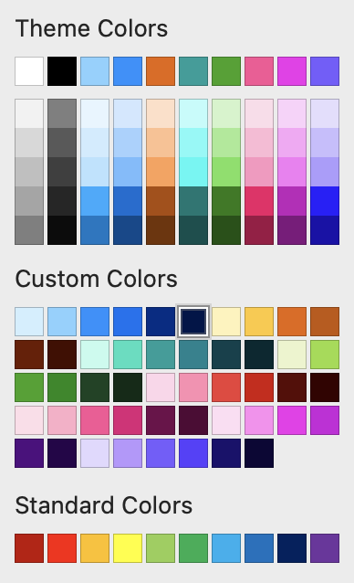


Template Information
Please use the first row of the PowerPoint Theme Colors and the shadings in Custom Colors.
SAP Brand Palette
Don’t use this colors, as these are tints autogenerated by Powerpoint and are NOT official-brand colors.
Secondary Palette
On-brand tints and shades have been added to the custom colors.
Don‘t use the MS standard colors. These are no brand colours
Hover over a Color Swap if you are unsure and a tooltip will appear showing the correct Color Name

Slide 37
Additional information
Images
If you need to use images/pictograms, please check our Media Library https://brand.sap.com/media-library/index.html#/
Other sources (Adobe Stock, Microsoft), see details here https://brand.sap.com/photography-sources-use-rights#sources
Templafy also offers images and pictograms
Don't use imagery from the internet advertised as “free,” (e.g. from Google Images, Pexels, or Pixabay).
Don't use personal or private photography for any SAP content, as SAP needs to own the rights to each asset.
Third-party content:
SAP Legal advises that written permission is required to use third-party logos and quotes, see the Content Permission Handbook
Artificial Intelligence:
Principles, guidance, and rules for using AI in a way consistent with the SAP Brand, find details here: https://brand.sap.com/artificial-intelligence
Customer presentations
Please be aware that Customers and Partners are not permitted to use any SAP brand visual elements (e.g., PPT template, pictograms, photography etc.) SAP brand elements are proprietary to SAP and are only intended for SAP to use.
Customers and Partners should use their own corporate identity.
If slides from SAP and Customer/Partner are combined in one presentation, both should keep their formatting.

